Slide 1
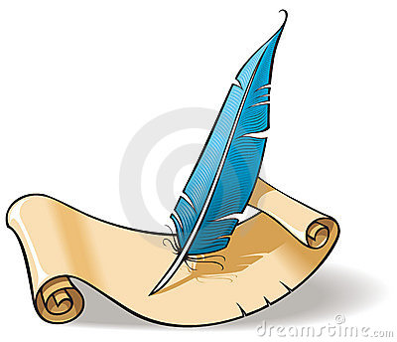
J’écris à mon correspondent
To write your first letter in French to your pen pal

Slide 2
Top tips to write letters
Write out a draft letter. Your teacher will then correct it.
When you are confident your letter is correct. Rewrite a final copy of it.
Write as neatly as possible

Slide 3
More top tips to write letters
To make your letter more interesting, use nice stationery or decorate it with colourful designs and drawings
You could include some things that may interest your pen pal such as stickers, magazine cuttings or postcards
AND…. Have fun!

Slide 4
Writing to your pen pal What to include in your first letter
1 – town/village
and date

Slide 5
Writing to your pen pal What to include in your first letter
2 - Greetings

Slide 6
Writing to your pen pal What to include in your first letter
3 – Your name

Slide 7
Writing to your pen pal What to include in your first letter
4 – your age

Slide 8
Writing to your pen pal What to include in your first letter
5 – where you live
Tip : Do not give them your address, just the name of the town/village where you live!

Slide 9
Writing to your pen pal What to include in your first letter
6 – if you are a girl or a boy
Why do you think you may want to include this information?

Slide 10
Writing to your pen pal What to include in your first letter
7 – your likes

Slide 11
Writing to your pen pal What to include in your first letter
8 – your dislikes

Slide 12
Writing to your pen pal What to include in your first letter
9 – end salutations

Slide 13
Writing to your pen pal What to include in your first letter
10 – your name

Slide 15
Exemple de lettre
Town/village
Bonjour! date
Je m’appelle
J’ai
J’habite à , en/au
your country
Je suis une fille/un garçon.
J’aime et
Je n’aime pas
Au revoir!
Your name

Slide 16
Exemple de lettre
,le
Town/village, date
Bonjour!
Je m’appelle .
J’ai . Quel âge as-tu?
J’habite à , en/au . Où habites-tu?
your country
Je suis une fille/un garçon.
J’aime et
Je n’aime pas
Au revoir!
Your name

